Slide 1
Data Structure and Algorithm (Graph)
Dr. Sambit Bakshi

Slide 2
Graph
A graph is a collection of nodes (or vertices) and edges (or arcs)
Each node contains an element
Each edge connects two nodes together (or possibly the same node to itself) and may contain an edge attribute
A directed graph is one in which the edges have a direction
An undirected graph (graph) is one in which the edges do not have a direction

Slide 3
What is a Graph?
A graph G = (V,E) is composed of:
V: set of vertices
E: set of edges connecting the vertices in V
An edge e = (u,v) is a pair of vertices
Example:
a
b
V= {a,b,c,d,e}
E= {(a,b),(a,c),(a,d),
(b,e),(c,d),(c,e),(d,e)}
c
d
e

Slide 4
a digraph (Oriented or Directed graph)
A
B
E
C
D
V = {A, B, C, D, E}
E = {<A,B>, <B,C>, <C,B>, <A,C>, <A,E>, <C,D>}

Slide 5
Directed vs Undirected graph
An undirected graph is one in which the pair of vertices in a edge is unordered, (v0, v1) = (v1,v0)
A directed graph is one in which each edge is a directed pair of vertices, <v0, v1> != <v1,v0>
tail
head

Slide 6
Graph terminologies
The size of a graph is the number of nodes in it
The empty graph has size zero (no nodes)
If two nodes are connected by an edge, they are neighbors (and the nodes are adjacent to each other)
The degree of a node is the number of edges it has
For directed graphs,
If a directed edge goes from node S to node D, we call S the source and D the destination of the edge
The edge is an out-edge of S and an in-edge of D
S is a predecessor of D, and D is a successor of S
The in-degree of a node is the number of in-edges it has
The out-degree of a node is the number of out-edges it has

Slide 7
Graph terminologies
path: sequence of vertices v₁,v₂,v₃. . .v_{k} such that consecutive vertices v_{i} and v_{i+1} are adjacent.
a
b
a
b
c
c
d
e
d
e
a b e d c
b e d c

Slide 8
More Terminology
simple path: no repeated vertices
cycle: simple path, except that the last vertex is the same as the first vertex
a
b
b e c
c
d
e

Slide 9
Even More Terminology
connected graph: any two vertices are connected by some path
connected
not connected
subgraph: subset of vertices and edges forming a graph

Slide 10
Subgraph Examples
0
0
0
1
2
0
1
2
1
2
3
1
2
3
G1
(i) (ii) (iii) (iv)
(a) Some subgraphs of G₁
3
0
0
0
0
0
1
1
1
1
G₂
2
2
2
(i) (ii) (iii) (iv)
(b) Some subgraphs of G₂

Slide 11
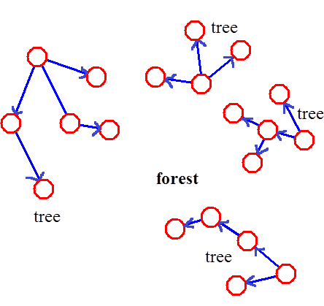
More…
tree - connected digraph without cycles
forest - collection of trees

Slide 12
Connectivity
Let n = #vertices, and m = #edges
A complete graph: one in which all pairs of vertices are adjacent
How many total edges in a complete graph?
Each of the n vertices is incident to n-1 edges, however, we would have counted each edge twice! Therefore, intuitively, m = n(n -1)/2.
Therefore, if a graph is not complete, m < n(n -1)/2

Slide 13
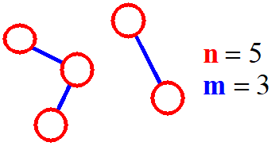
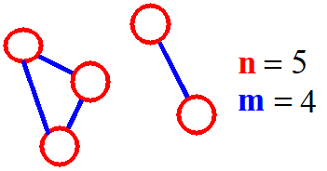
More on Connectivity
n = #vertices
m = #edges
For a tree m = n - 1
If m < n - 1, G is not connected, but the reverse is not necessarily true, i.e. m !< n-1 does not necessary confirm that G is connected.

Slide 14
Graph Terminologies
An undirected graph is connected if there is a path from every node to every other node
A directed graph is strongly connected if there is a path from every node to every other node
A directed graph is weakly connected if it is not strongly connected but the underlying undirected graph is connected
Node X is reachable from node Y if there is a path from Y to X

Slide 15
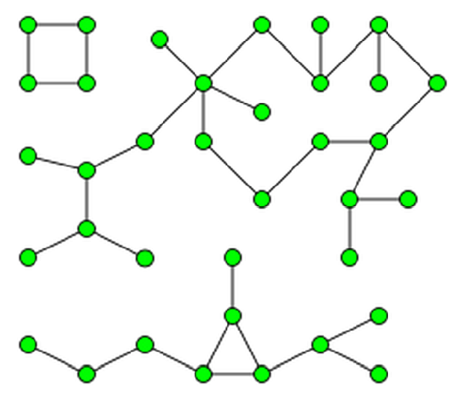
Graph Terminologies
Connected component (or Component): of a graph is a subgraph which is connected
Graph with 3 connected components

Slide 16
graph data structures
storing the vertices
each vertex has a unique identifier and, maybe, other information
for efficiency, associate each vertex with a number that can be used as an index
storing the edges
adjacency matrix – represent all possible edges
adjacency lists – represent only the existing edges

Slide 17
storing the vertices
when a vertex is added to the graph, assign it a number
vertices are numbered between 0 and n-1
graph operations start by looking up the number associated with a vertex
many data structures to use
for small graphs a vector can be used
search will be O(n)

Slide 18
the vertex vector
0
A
1
4
0
1
2
3
4
A B C D E
B
E
C
D
2
3

Slide 19
adjacency matrix
A_{nxn},where n:# of vertices
A[i][j]=1 if (i,j) is an edge
=0 otherwise
0
1
2
3
4
A B C D E
0
A
4
0 1 2 3 4
1
B
E
0
1
2
3
4
0 1 1 0 1
0 0 1 0 0
0 1 0 1 0
0 0 0 0 0
0 0 0 0 0
C
D
2
3

Slide 20
Examples for Adjacency Matrix
0
0
1
2
1
3
G2
G1
2
Asymmetric
symmetric

Slide 21
Space required
a n² matrix is needed for
a graph with n vertices

Slide 22
many graphs are “sparse”
degree of “sparseness” is key factor in choosing a data structure for edges
adjacency matrix requires space for all possible edges
adjacency list requires space for existing edges only
affects amount of memory space needed
affects efficiency of graph operations

Slide 23
adjacency lists
0
0
1
2
3
4
A B C D E
A
1
4
B
E
C
D
0
1
2
3
4
1 2 4
2
3
2
1
3

Slide 24
adjacency lists
0
0
1
2
3
1
2
3
0
2
3
1
2
G1
0
1
3
3
0
1
2
0
0
1
2
1
G2
0
2
1
2

Slide 25
Shortest-Path (Least-Cost) Algorithms
Dijkstra’s Algorithm
Find shortest paths from a source s to all other nodes.
N: Set of Nodes
s: source node
M: Set of processed nodes
d_{ij}: Link cost from node i to node j;
d_{ii}=0
d_{ij}=∞, if edge (i,j) does not exist
d_{ij} ≥ 0, if edge (i,j) exists
D_{n}: Current least cost from node s to node n that is known to the algorithm

Slide 26
Dijkstra's Shortest Path Algorithm
[Initialize]
M={s} [set of processed nodes is source node only]
D_{n}=d_{sn} for all n ≠ s [initial path costs to the nodes are simply link costs
P_{k}=s→k for neighobor nodes k or s [shortest path to neighbor nodes]
Find node w ∉ M such that D_{w}=min{D_{j}} for j ∉ M
Update D_{k} for all k adjacent to w
If (D_{w}+d_{wk} < D_{k}) then do
D_{k} = D_{w}+d_{wk}
P_{k}= P_{w}→ k
end if

Slide 27
Dijkstra's Shortest Path Algorithm
Find shortest path from s to all other nodes.
2
24
3
9
s
18
14
6
6
2
30
4
19
11
15
5
5
6
20
16
7
8
44

Slide 28
Dijkstra's Shortest Path Algorithm
Shortest Paths
P2: s-2
P3:
P4:
P5:
P6: s-6
P7: s-7
M = { s }
NT = { 2, 3, 4, 5, 6, 7, 8 }
D₂
∞
9
2
24
3
0
9
s
D₆
14
18
14
6
6
2
∞
30
∞
4
19
11
15
5
5
6
20
16
7
8
44
D₇
15
∞

Slide 29
Dijkstra's Shortest Path Algorithm
Shortest Paths
P2: s-2
P3:
P4:
P5:
P6: s-6
P7: s-7
M = { s }
NT = { 2, 3, 4, 5, 6, 7, 8 }
W
∞
9
2
24
3
0
9
s
14
18
14
6
6
2
∞
30
∞
4
19
11
15
5
5
6
20
16
7
8
44
15
∞

Slide 30
Dijkstra's Shortest Path Algorithm
Shortest Paths
P2: s-2
P3:
P4:
P5:
P6: s-6
P7: s-7
M = { s, 2 }
NT = { 3, 4, 5, 6, 7, 8 }
W
∞
9
2
24
3
0
9
s
14
18
14
6
6
2
∞
30
∞
4
19
11
15
5
5
6
20
16
7
8
44
15
∞

Slide 31
Dijkstra's Shortest Path Algorithm
Shortest Paths
P2: s-2
P3: P2-3 ~ s-2-3
P4:
P5:
P6: s-6
P7: s-7
M = { s, 2 }
NT = { 3, 4, 5, 6, 7, 8 }
Update cost
∞
33
9
X
2
24
3
0
9
s
14
18
14
6
6
2
∞
30
∞
4
19
11
15
5
5
6
20
16
7
8
44
15
∞

Slide 32
Dijkstra's Shortest Path Algorithm
Shortest Paths
P2: s-2
P3: P2-3 ~ s-2-3
P4:
P5:
P6: s-6
P7: s-7
M = { s, 2 }
NT = { 3, 4, 5, 6, 7, 8 }
∞
33
9
X
2
24
3
0
9
W
s
14
18
14
6
6
2
∞
30
∞
4
19
11
15
5
5
6
20
16
7
8
44
15
∞

Slide 33
Dijkstra's Shortest Path Algorithm
Shortest Paths
P2: s-2
P3: P6-3 ~ s-6-3
P4:
P5: P6-5 ~ s-6-5
P6: s-6
P7: s-7
M = { s, 2, 6 }
NT = { 3, 4, 5, 7, 6 }
32
∞
33
9
X
X
2
24
3
0
9
s
14
18
14
6
6
2
44
∞
∞
4
30
X
19
11
15
5
5
6
20
16
7
8
44
15
∞

Slide 34
Dijkstra's Shortest Path Algorithm
Shortest Paths
P2: s-2
P3: P6-3 ~ s-6-3
P4:
P5: P6-5 ~ s-6-5
P6: s-6
P7: s-7
M = { s, 2, 6 }
NT = { 3, 4, 5, 7, 8 }
32
∞
33
9
X
X
2
24
3
0
9
s
14
18
14
6
6
2
44
∞
∞
4
30
X
19
11
15
5
5
6
20
16
7
8
44
15
W
∞

Slide 35
Dijkstra's Shortest Path Algorithm
Shortest Paths
P2: s-2
P3: P6-3 ~ s-6-3
P4:
P5: P7-5 ~ s-7-5
P6: s-6
P7: s-7
P8: P7-8 ~ s-7-8
M = { s, 2, 6, 7 }
NT = { 3, 4, 5, 8 }
32
∞
33
9
X
X
2
24
3
0
9
s
14
18
14
6
6
2
44
35
∞
X
∞
4
30
X
19
11
15
5
5
6
20
16
7
8
44
59
∞
15
X

Slide 36
Dijkstra's Shortest Path Algorithm
Shortest Paths
P2: s-2
P3: P6-3 ~ s-6-3
P4:
P5: P7-5 ~ s-7-5
P6: s-6
P7: s-7
P8: P7-8 ~ s-7-8
M = { s, 2, 6, 7 }
NT = { 3, 4, 5, 8 }
W
32
∞
33
9
X
X
2
24
3
0
9
s
14
18
14
6
6
2
44
35
∞
X
∞
4
30
X
19
11
15
5
5
6
20
16
7
8
44
59
∞
15
X

Slide 37
Dijkstra's Shortest Path Algorithm
Shortest Paths
P2: s-2
P3: P6-3 ~ s-6-3
P4:
P5: P3-5 ~ s-6-3-5
P6: s-6
P7: s-7
P8: P3-8 ~ s-6-3-8
M = { s, 2, 3, 6, 7 }
NT = { 4, 5, 8 }
32
∞
33
9
X
X
2
24
3
0
9
s
14
18
14
6
6
2
44
35
34
∞
X
X
∞
4
30
X
19
11
15
5
5
6
20
16
7
8
44
51
59
∞
15
X
X

Slide 38
Dijkstra's Shortest Path Algorithm
Shortest Paths
P2: s-2
P3: s-6-3
P4:
P5: P3-5 ~ s-6-3-5
P6: s-6
P7: s-7
P8: P3-8 ~ s-6-3-8
M = { s, 2, 3, 6, 7 }
NT = { 4, 5, 8 }
32
∞
33
9
X
X
2
24
3
0
9
s
14
18
14
6
6
2
44
35
34
∞
X
X
∞
4
30
X
19
11
15
5
5
6
20
W
16
7
8
44
51
59
∞
15
X
X

Slide 39
Dijkstra's Shortest Path Algorithm
Shortest Paths
P2: s-2
P3: s-6-3
P4: P5-4 ~ s-6-3-5-4
P5: s-6-3-5
P6: s-6
P7: s-7
P8: P5-8 ~ s-6-3-5 -8
M = { s, 2, 3, 5, 6, 7 }
NT = { 4, 8 }
32
∞
33
9
X
X
2
24
3
0
9
s
14
18
14
6
6
2
35
34
45
∞
44
X
X
X
∞
4
30
X
19
11
15
5
5
6
20
16
7
8
44
50
51
59
∞
15
X
X
X

Slide 40
Dijkstra's Shortest Path Algorithm
Shortest Paths
P2: s-2
P3: s-6-3
P4: P5-4 ~ s-6-3-5-4
P5: s-6-3-5
P6: s-6
P7: s-7
P8: P5-8 ~ s-6-3-5 -8
M = { s, 2, 3, 5, 6, 7 }
NT = { 4, 8 }
32
∞
33
9
X
X
2
24
3
0
9
s
14
18
14
6
6
2
35
34
45
∞
44
X
X
X
∞
4
30
X
19
11
15
5
W
5
6
20
16
7
8
44
50
51
59
∞
15
X
X
X

Slide 41
Dijkstra's Shortest Path Algorithm
Shortest Paths
P2: s-2
P3: s-6-3
P4: s-6-3-5-4
P5: s-6-3-5
P6: s-6
P7: s-7
P8: P5-8 ~ s-6-3-5 -8
M = { s, 2, 3, 4, 5, 6, 7 }
NT = { 8 }
32
∞
33
9
X
X
2
24
3
0
9
s
14
18
14
6
6
2
35
34
45
∞
44
X
X
X
∞
4
30
X
19
11
15
5
5
6
20
16
7
8
44
50
51
59
∞
15
X
X
X

Slide 42
Dijkstra's Shortest Path Algorithm
Shortest Paths
P2: s-2
P3: s-6-3
P4: s-6-3-5-4
P5: s-6-3-5
P6: s-6
P7: s-7
P8: P5-8 ~ s-6-3-5 -8
M = { s, 2, 3, 4, 5, 6, 7 }
NT = { 8 }
32
∞
33
9
X
X
2
24
3
0
9
s
14
18
14
6
6
2
35
34
45
∞
44
X
X
X
∞
4
30
X
19
11
15
5
5
6
20
16
7
8
44
W
50
51
59
∞
15
X
X
X

Slide 43
Dijkstra's Shortest Path Algorithm
Shortest Paths
P2: s-2
P3: s-6-3
P4: s-6-3-5-4
P5: s-6-3-5
P6: s-6
P7: s-7
P8: s-6-3-5 -8
M = { s, 2, 3, 4, 5, 6, 7, 8 }
NT = { }
32
∞
33
9
X
X
2
24
3
0
9
s
14
18
14
6
6
2
35
34
45
∞
44
X
X
X
∞
4
30
X
19
11
15
5
5
6
20
16
7
8
44
50
51
59
∞
15
X
X
X

